Slide 1
THE PERFECT BLEND OF PROFIT: BYU BLEND(PINEAPPLE MIRAGE) ANNUAL FINANCIAL ANALYSIS. BY PEACE AIGBOKHAEBHOLO, DAVID AUGUSTINE, WINIFRED NZEKA, EMMANUEL OPARA, FRANCISCA ANDOH, AKANBI OLUWAFEMI, BILL COLEMAN, AUGUSTA ANTHONY ISONG

Slide 2
BYU BLEND (Pineapple Mirage)Objectives
To highlight the financial viability of BYU BLEND (Pineapple Mirage) by breaking down key cost factors, revenue strategies, and profitability metrics.

Slide 3
Data Analysis For BYU BLEND
Annual fixed cost: BYU BLEND’s annual fixed costs total $5,210.64, covering essential overheads required to operate consistently throughout the year. These fixed costs are incurred regardless of production levels and for Byu Blend our annual fixed cost include expenses for shop rent, and utilities( Power, water, trash). Which we considered critical for budgeting and pricing decisions. Byu Blend Annual fixed cost was realized by adding shop rent value with the Utilities value, then multiply both 12 which represents the number of months in a year.
Variable Cost Per Cup: BYU BLEND’s variable cost per cup is $0.30, representing the direct cost incurred for producing each additional cup sold. This cost includes purchase of ingredients used and packaging, with each unit produced. The BYU BLEND Team considered this crucial for calculating profit margins and setting selling prices.

Slide 4
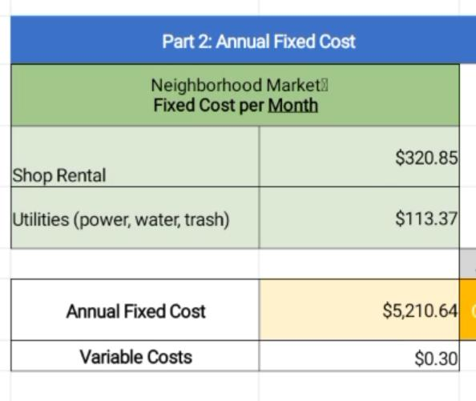
BYU BLEND Annual fixed cost and Variable Cost Diagram

Slide 5
Data Analysis For BYU BLEND Cont’d
Price and Percent of Demand: BYU BLEND’s set price per cup is $0.10. From the graph analysis, BYU BLEND customer demand rate increased to 15% at $1.20, resulting to less demand for the product. And as the price adjust so the demand increased from the 15% to 50% at $0.90, 60% at $0.80, 85% demand increase at 0.60 and 95% demand rate increase at $0.50. The price point at intervals, indicates the affordability and profitability projection. Which reflected an anticipated customer interest and helped in estimating the revenue and inventory needs accurately. The next slide shows the graphical illustration of BYU BLEND price and percent of demand.

Slide 6
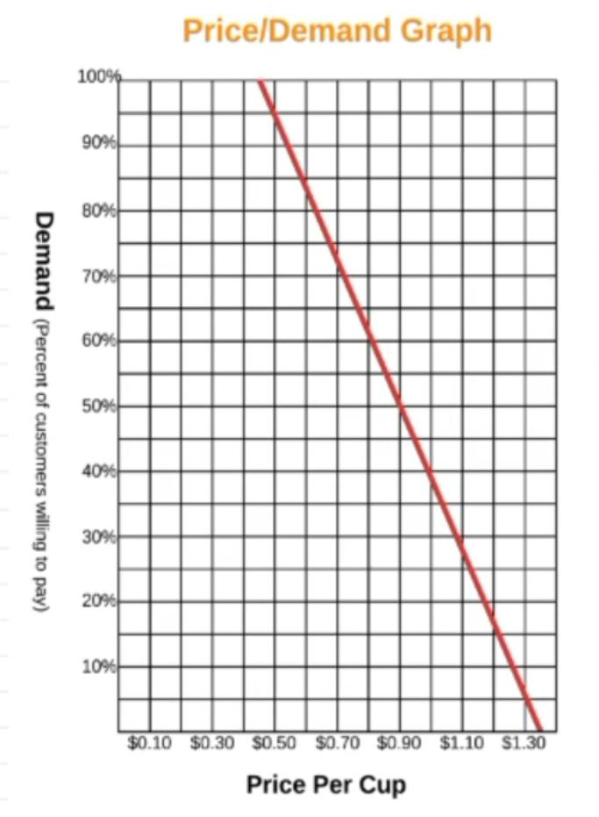
BYU BLEND Price and Percent Of Demand Graph

Slide 7
Data Analysis For BYU BLEND Cont’d
Break-Even Point :BYU BLEND’s break-even point is $10,421, which was calculated by dividing total fixed costs by the profit per cup (price minus variable cost), helping assess risk and set realistic sales goals. Meaning the business starts making a profit after selling a certain amount of cups of Byu blend.
Annual Net Profit: BYU BLEND’s annual net profit is ₦2,820, reflecting total earnings after covering all fixed and variable costs. The figure above demonstrates the business’s overall financial health and efficiency, showing the surplus remaining after all expenses are deducted from total revenue.

Slide 8
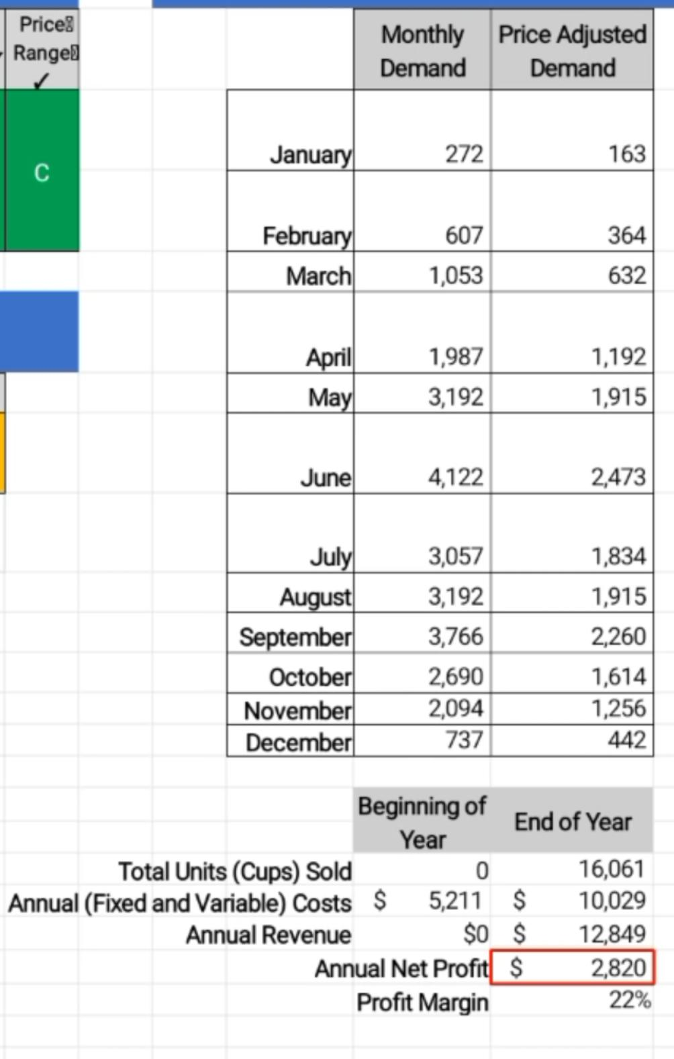
BYU BLEND (Pineapple Mirage) Annual Net Profit Diagram

Slide 9
Data Analysis For BYU BLEND Cont’d
Break-Even Analysis Graph: The break-even analysis graph shows the point where total revenue equals total costs, marking the start of profitability. The graph illustrates how changes in sales volume impacts the profit, with the intersection of the cost and revenue lines indicating the break-even point. Which is an essential tool to any decision-making and financial planning. The next two slides explain this in details with a graph of BYU BLEND (Pineapple Mirage).

Slide 10
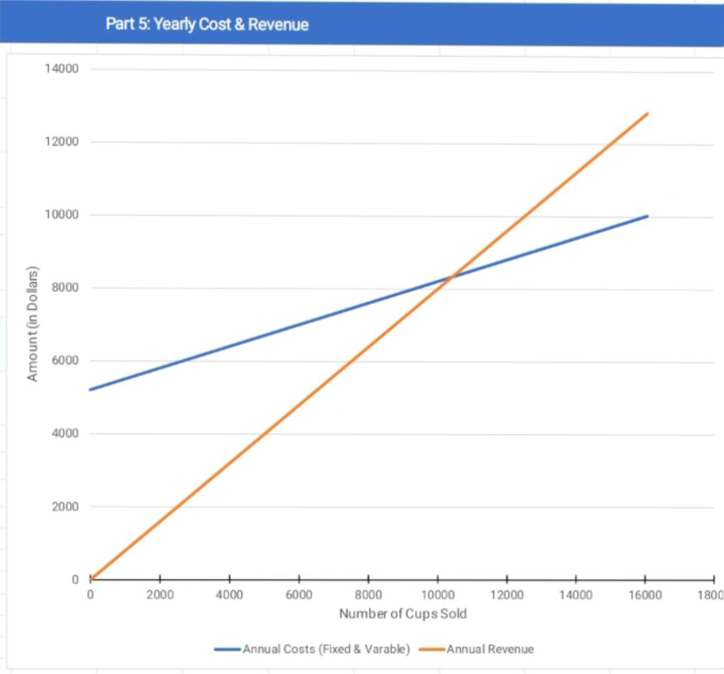
BYU BLEND Break-Even Analysis Graph

Slide 11
BYU BLEND Break-Even Analysis Graph Explained
A break-even point graph as earlier explained, shows where total revenue equals total costs. The point where the business neither makes a profit nor a loss. The BYU BLEND (Pineapple Mirage) graph on the previous slide displayed this, where the blue line represented the annual cost against the orange line representing the annual revenue. From the graph we realized the Break-Even Point at $10,421 with the intersection of both lines. The graph identified how many units sold to cover all expenses, and the profit realized above the break even point. Making it a key tool for planning, pricing, and profitability analysis for the team.

Slide 12
Persuasive Statement for Presentation
By effectively managing BYU BLEND’s annual fixed costs of ₦5,210.64 and maintaining a variable cost of $0.30 per cup, we’ve strategically priced each cup at $0.60 to meet an anticipated 85% demand, and at $0.50 to foster more anticipated demand of 95%. Our break-even point at just $10,421 means we were able quickly cover costs and begin earning profits. With an annual net profit of ₦2,820, therefore BYU BLEND is positioned for sustainable growth. The break-even analysis graph clearly illustrated how sales volume impacts profitability, empowering us to make confident, data-driven decisions to maximize success.

Slide 13
Conclusion
In summary, BYU BLEND (Pineapple Mirage)has a strong financial foundation with controlled costs, strategic pricing, and clear demand. Our break-even point is achievable, and the projected net profit confirms the business’s potential for sustainable growth. By leveraging these insights, we are well-positioned to make informed decisions and achieve long-term success.

